Slide 1



Satan’s
If I Were
MINISTER
(continued)

Slide 2
REPENTANCE
Exposing False Reasons For Refusing To Preach On
The teaching of men versus the teaching of God
Notes:
This is our subject for today…Repentance. We want to compare mans’ thinking to God’s and in doing so to establish a clear concept of this essential quality. Is repentance simply a change of mind?

Slide 3
False Claims Against Preaching Repentance
You don’t get people to repent by preaching on repentance
  “Repentance matters a great deal, but you don’t get people to repent by preaching repentance” (Paul Ellis)

Slide 4

“You don’t get people to repent preaching repentance.”
Luke 24:46, 47:
“Then He said to them, ‘Thus it is written, and thus it was necessary for the Christ to suffer and to rise from the dead the third day, and that repentance and remission of sins should be preached in His name to all nations, beginning at Jerusalem.”
Notes:
Someone should have told Jesus that.

Slide 5
False Claims Against Preaching Repentance
Preaching repentance puts people under law
  “Preach ‘turn from sin or you’re not saved’ and you are preaching pure law. You are prescribing sin-rejection as a means for salvation” (Paul Ellis)
Notes:
Ellis must therefore embrace a lawless gospel! If we can sin, we are under law. We cannot sin and have no law. Because we can sin, we must have law. In fact, committing sin is committing lawlessness (1 Jn. 3:4). So by not preaching against sin, one actually encourages a lawless religion!

Slide 6
“Preaching repentance puts people under law.”
Was the Lord’s preaching putting people under Law and not mercy?
Matthew 9:10-13; cf. Lk. 5:32
Were the apostles putting people under law and not mercy?
Acts 2:38; 8:22; 17:30; 20:21; 26:20

Slide 7
Are Christians under Law toward Christ?
1 Corinthians 9:21, “to those who are without law, as without law (not being without law toward God, but under law toward Christ), that I might win those who are without law”
Notes:
Where will the lawless stand before Christ (Matt. 7:23; 13:41; 23:28)?

Slide 8
False Claims Against Preaching Repentance
We don’t do anything to deal with our sins
  “We don’t do anything to deal with our sins for Jesus has done it all. Our part is to believe the good news and say thank you Jesus! It is when we receive his gift of no condemnation that we are empowered to go and sin no more” (Paul Ellis)

Slide 9
“We don’t do anything to deal with sin.”
The message of a TRUE “grace preacher” Titus 2:11-15
What does grace teach us?
What is to be denied?
Who deals with “denying” ungodliness & worldliness?

Slide 10

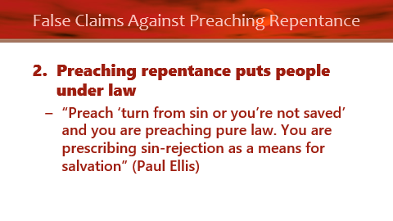
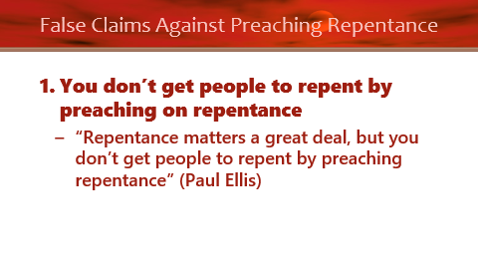
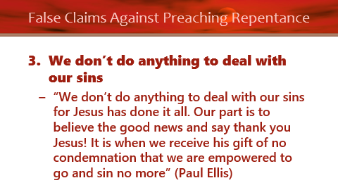
“We don’t do anything to deal with sin.”
The message of a TRUE “grace preacher” Titus 2:11-15
Who is to live soberly, righteously, & godly?
Are preachers of grace commanded to preach this?

Slide 11

If I were Satan’s Minister…
“Repentance and faith are inseparable acts.”
Notes:
They say that since we are dead in trespasses, it is impossible for us to save ourselves and that God must raise us up from the dead in order to believe (Eph. 2:1, 5). Hence, God must first take direct action upon us to make us alive so that we can be saved by faith making faith itself a gift of God.

Slide 12
Repentance Distinguished From Faith
Know what?
ACTS 2
36 "Therefore let all the house of Israel know assuredly that God has made this Jesus, whom you crucified, both Lord and Christ."
37 Now when they heard this, they were cut to the heart, and said to Peter and the rest of the apostles, "Men and brethren, what shall we do?"
38 Then Peter said to them, "Repent, and let every one of you be baptized in the name of Jesus Christ for the remission of sins; …
Did They Believe?
Why Say This?
Notes:
How would a strict Calvinist have responded if he were in Peter’s sandals?

Slide 13
If I were Satan’s Minister…
“Repentance and faith are inseparable acts.”
“Repentance is a gift from God.”
Notes:
They say that since we are dead in trespasses, it is impossible for us to save ourselves and that God must raise us up from the dead in order to believe (Eph. 2:1, 5). Hence, God must first take direct action upon us to make us alive so that we can be saved by making us repent and believe—faith and repentance a gift.

Slide 14
Repentance as a GIFT?
2 Timothy 2:24, 25
  “And a servant of the Lord must not quarrel but be gentle to all, able to teach, patient, in humility correcting those who are in opposition, if God perhaps will grant them repentance, so that they may know the truth”
Notes:
I have had this very passaged used in a public debate insisting that repentance is a gift of God, making it something that you cannot attain unless God gives it to you. What I have grown to learn through the years is that nine times out of ten, the very passage false teachers use is refuted by that passage or within the immediate context.

Slide 15
Repentance as a GIFT?
Acts 11:18
  “When they heard these things they became silent; and they glorified God, saying, ‘Then God has also granted to the Gentiles repentance to life.’”

Slide 16
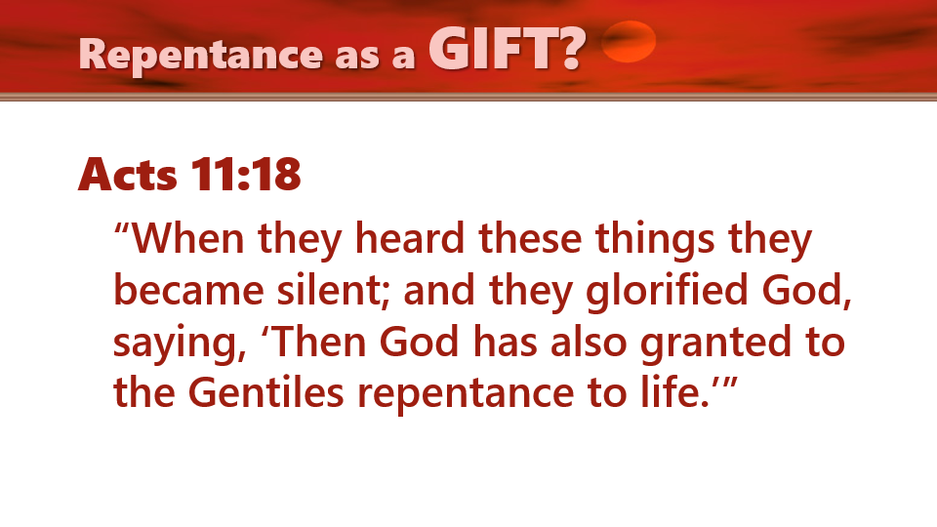
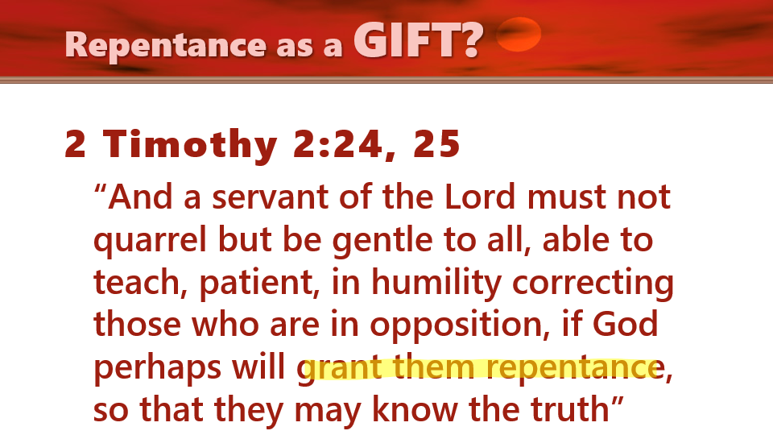

How does God grant repentance?
Is repentance something man must do for himself (Lk. 13:3)?
If the ability to repent comes from God, then all should be saved (2 Pet. 3:9; cf. Acts 17:30)!
Notes:
RE: 2 Timothy 2:24, 25 If repentance is a gift that God directly places into a man’s heart, separate and apart from the man’s own prerogative, then why did Paul warn Timothy against quarreling and insisting gentleness of heart, patience and humility in correcting those who oppose? If repentance is independent of a man’s own will, why must Timothy take care in these areas? In fact, why use Timothy at all? The truth of the matter is, that when we preach God’s word, it brings about repentance and conviction of the heart which, is a gift from God through the medium of preaching/teaching the word!
RE: Acts 11:18. God granted the Gentiles repentance by sending the gospel to them to hear and obey. When the Holy Spirit fell on the household of Cornelius, something which never happened to any other household, He was not doing such to show these Gentiles were saved, but rather, to confirm to the Jews that He had approved Peter going to preach to the Gentiles!
RE: Lk. 13:3, These people minimized their sins and were subject to think that really bad things happen to really bad sinners. The bible doesn’t classify sin as big or little despite the fact that some sins are more grievous than others. Let us not fall into the rut of comparing our sins with others in order to justify ourselves.
RE: 2 Pet. 3:9. Why would anyone be lost if God desires all to be saved and yet, He alone has the power to give them the gift to repent? Further, why would He command all men to repent if it is 100 percent dependent upon God? On any command, we are left with two choice: to obey or to disobey. Repentance is a command of God. This begs the question why some who claim to be grace preachers would not preach something that God demands every person to do!

Slide 17
Acts 5:30, 31
30 "The God of our fathers raised up Jesus whom you murdered by hanging on a tree.
31 "Him God has exalted to His right hand to be Prince and Savior, to give repentance to Israel and forgiveness of sins.
HOW?
By His Resurrection and Ascension
By Giving the Spirit to the Apostles (Jn. 16:7-13; Acts 5:32)
By Preaching (Acts 5:19,
20, 25, 42; Matt. 12:41)

Slide 18
God Grants Men Repentance
By having His word preached to them
By giving them opportunity (time) to repent
  When God gives someone time and the word, He is granting him repentance (Rev. 2:5, 16, 21)
  The need to speedily repent exists for anyone living in sin (Rev. 3:19)
Notes:
2. As Tyler preached that time is created by God, controlled by God and is therefore a gift from God. When He gives time to repent, He is granting repentance.

Slide 19
What is Involved in Fruitful Repentance?
Our emotion is changed
  2 Corinthians 7:10
Our view of self is changed
  Isaiah 6:5; Job 42:6; Luke 5:8; etc.
Our will is changed
  Matthew 21:28-31; Proverbs 1:23; Ezek. 33:11
Notes:
View of ourselves See also Job 42:6; Lk. 5:8; 1 Timothy 1:15
Matthew 21:28-31.
God’s word call us to do what (v. 28)? Work. It calls us to work when? Today. It calls us to work where? In the Lord’s vineyard. The first son said he “will” not. But when he later regretted what he had done, what did he do? He went. Repentance is the follow through to do the work God wants you to do. The prodigal could not stay with the pigs, but had to get up and go back to his father in order to repent. The problem with many at Corinth was that they would not change their will in the face of the teaching of the gospel (2 Cor. 12:20, 21).

Slide 20


social, health,
and wealth gospel
doctrinal tolerance
faith only
Forest of
CLUTTER
denominationalism
Eternal
Life
one-man
pastor system
entertainment
filled worship
PATH TO LIFE
wholly of grace
minimizing
truth/doctrine
worldliness
Matthew 7:13, 14
Notes:
Jesus speaks of the way to life being through a “narrow gate.” The connection exists between the gate and the way. Into the broad “way” is a “wide gate” because the masses go through it and travel on it. It is the pathway of tolerance. The narrow gate would necessarily imply a narrow way. The KJV translates, “Because strait is the gate, and narrow is the way, which leadeth unto life…” (v. 14). “Narrow” in the Greek, is not an adjective, but rather a verb which shows that this way compresses, contracts, afflicts, distresses and causes trouble. This is why it is the New King James translates it “difficult.” [click to get traps for your soul]
It is like a show I watched where some men were hunting to find a Brazilian wandering spider which is considered to be the most venomous spider in the world. They were hunting for it in a cave where they had to travers all kinds of obstacles. The cave had places where it narrowed where the spider hunters would have to go through feet first through a small hole which barely had enough space for a man to pass. It was a course that was difficult and filled with distress and afflictions. Now it amazes me that men will pursue such a dangerous goal and are willing to vex themselves in their chase to hunt a deadly spider. Yet how ironic it is that when it comes to eternal life, few are willing to travel the course and be pressed with some temporary trials. It amazes me that some who hunt such a venomous spider have more staying power to the course than those who are walking on the path to life.
In the two roads which our Lord speaks of, lets appreciate a couple more truths. Jesus is calling people to make a choice much like Elijah did to the people of his day who were undecided between Baal or Jehovah (1 Kin. 18:21). He is as Moses was before the people in Deuteronomy 11:26-28 and 30:15-18 or even as Joshua (Josh. 24:14, 15).
Of the two paths, we can travel only one. These paths do not cross or intersect and there are no short cuts from one to the other. The destinations of each path are spectacularly different—one to eternal life, the other to eternal ruin. The choice to travel one is the rejection of the other. You can enter upon the road only in this present life. Finally, avoiding the decision doesn’t make the choice go away. It only solidifies the choice to walk on the broad way.

